Slide 1
William Stallings
Data and Computer Communications
7th Edition
Chapter 19
Internetwork Protocols

Slide 2
Multicasting
Addresses that refer to group of hosts on one or more networks
Uses
  Multimedia “broadcast”
  Teleconferencing
  Database
  Distributed computing
  Real time workgroups

Slide 3
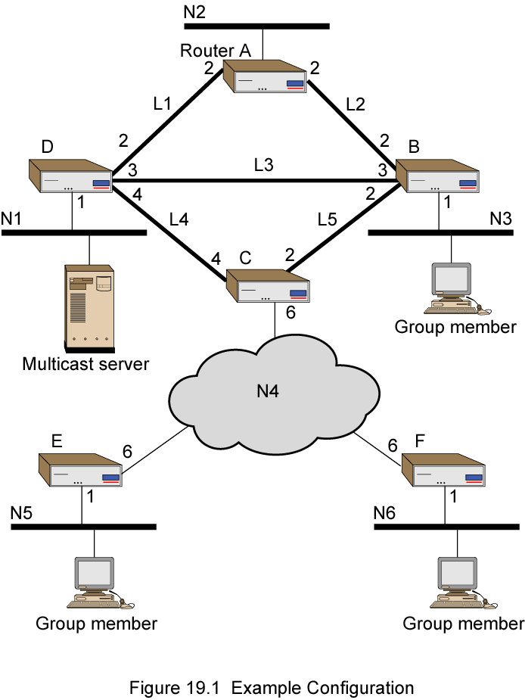
Example
Config

Slide 4
Broadcast and Multiple Unicast
Broadcast a copy of packet to each network
  Requires 13 copies of packet
Multiple Unicast
  Send packet only to networks that have hosts in group
  11 packets

Slide 5
True Multicast
Determine least cost path to each network that has host in group
  Gives spanning tree configuration containing networks with group members
Transmit single packet along spanning tree
Routers replicate packets at branch points of spanning tree
8 packets required

Slide 6
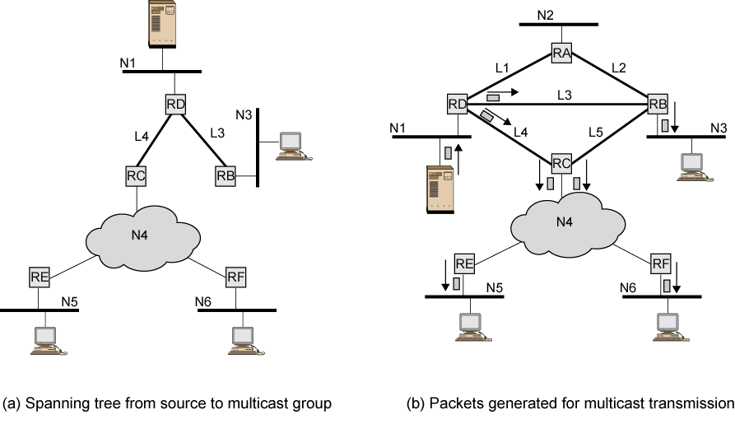
Multicast Example

Slide 7
Requirements for
Multicasting (1)
Router may have to forward more than one copy of packet
Convention needed to identify multicast addresses
  IPv4 - Class D - start 1110
  IPv6 - 8 bit prefix, all 1, 4 bit flags field, 4 bit scope field, 112 bit group identifier
Nodes must translate between IP multicast addresses and list of networks containing group members
Router must translate between IP multicast address and network multicast address

Slide 8
Requirements for
Multicasting (2)
Mechanism required for hosts to join and leave multicast group
Routers must exchange info
  Which networks include members of given group
  Sufficient info to work out shortest path to each network
  Routing algorithm to work out shortest path
  Routers must determine routing paths based on source and destination addresses

Slide 9
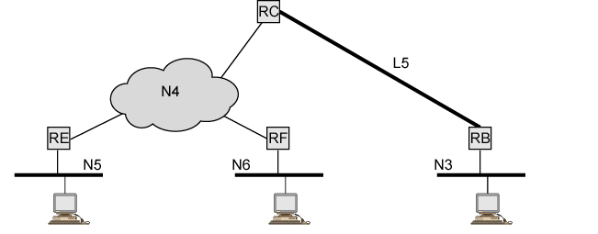
Spanning Tree from Router C to Multicast Group

Slide 10
Internet Group Management Protocol (IGMP)
RFC 3376
Host and router exchange of multicast group info
Use broadcast LAN to transfer info among multiple hosts and routers

Slide 11
Principle Operations
Hosts send messages to routers to subscribe to and unsubscribe from multicast group
  Group defined by multicast address
Routers check which multicast groups of interest to which hosts
IGMP currently version 3
IGMPv1
  Hosts could join group
  Routers used timer to unsubscribe members

Slide 12
Operation of IGMPv1 & v2
Receivers have to subscribe to groups
Sources do not have to subscribe to groups
Any host can send traffic to any multicast group
Problems:
  Spamming of multicast groups
  Even if application level filters drop unwanted packets, they consume valuable resources
  Establishment of distribution trees is problematic
  Location of sources is not known
  Finding globally unique multicast addresses difficult

Slide 13
IGMP v3
Allows hosts to specify list from which they want to receive traffic
  Traffic from other hosts blocked at routers
Allows hosts to block packets from sources that send unwanted traffic

Slide 14
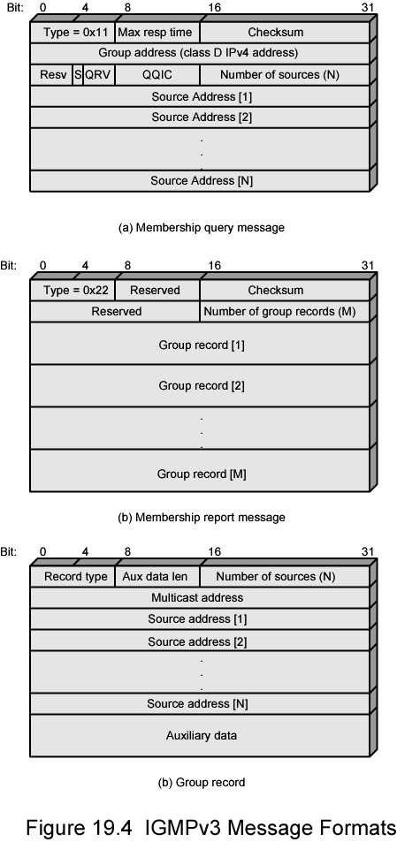
IGMP Message Formats
Membership Query

Slide 15
Membership Query
Sent by multicast router
General query
  Which groups have members on attached network
Group-specific query
  Does group have members on an attached network
Group-and-source specific query
  Do attached device want packets sent to specified multicast address
  From any of specified list of sources

Slide 16
Membership Query Fields (1)
Type
Max Response Time
  Max time before sending report in units of 1/10 second
Checksum
  Same algorithm as IPv4
Group Address
  Zero for general query message
  Multicast group address for group-specific or group-and-source
S Flag
  1 indicates that receiving routers should suppress normal timer updates done on hearing query

Slide 17
Membership Query Fields (2)
QRV (querier's robustness variable)
  RV value used by sender of query
  Routers adopt value from most recently received query
  Unless RV was zero, when default or statically configured value used
  RV dictates number of retransmissions to assure report not missed
QQIC (querier's querier interval code)
  QI value used by querier
  Timer for sending multiple queries
  Routers not current querier adopt most recently received QI
  Unless QI was zero, when default QI value used
Number of Sources
Source addresses
  One 32 bit unicast address for each source

Slide 18
IGMP Message Formats
Membership Report

Slide 19
Membership Reports
Type
Checksum
Number of Group Records
Group Records
  One 32-bit unicast address per source

Slide 20

IGMP Message Formats
Group Record

Slide 21
Group Record
Record Type
  See later
Aux Data Length
  In 32-bit words
Number of Sources
Multicast Address
Source Addresses
  One 32-bit unicast address per source
Auxiliary Data
  Currently, no auxiliary data values defined

Slide 22
IGMP Operation - Joining
Host using IGMP wants to make itself known as group member to other hosts and routers on LAN
IGMPv3 can signal group membership with filtering capabilities with respect to sources
  EXCLUDE mode – all group members except those listed
  INCLUDE mode – Only from group members listed
To join group, host sends IGMP membership report message
  Address field multicast address of group
  Sent in IP datagram with Group Address field of IGMP message and Destination Address encapsulating IP header same
  Current members of group will receive learn of new member
  Routers listen to all IP multicast addresses to hear all reports

Slide 23
IGMP Operation –
Keeping Lists Valid
Routers periodically issue IGMP general query message
  In datagram with all-hosts multicast address
  Hosts that wish to remain in groups must read datagrams with this all-hosts address
  Hosts respond with report message for each group to which it claims membership
Router does not need to know every host in a group
  Needs to know at least one group member still active
  Each host in group sets timer with random delay
  Host that hears another claim membership cancels own report
  If timer expires, host sends report
  Only one member of each group reports to router

Slide 24
IGMP Operation - Leaving
Host leaves group, by sending leave group message to all-routers static multicast address
Send membership report message with EXCLUDE option and null list of source addresses
Router determine if there are any remaining group members using group-specific query message

Slide 25
Group Membership with IPv6
IGMP defined for IPv4
  Uses 32-bit addresses
IPv6 internets need functionality
IGMP functions incorporated into Internet Control Message Protocol version 6 (ICMPv6)
  ICMPv6 includes all of functionality of ICMPv4 and IGMP
ICMPv6 includes group-membership query and group-membership report message
  Used in the same fashion as in IGMP

Slide 26
Routing Protocols
Routing Information
  About topology and delays in the internet
Routing Algorithm
  Used to make routing decisions based on information

Slide 27
Autonomous Systems (AS)
Group of routers
Exchange information
Common routing protocol
Set of routers and networks managed by signle organization
A connected network
  There is at least one route between any pair of nodes

Slide 28
Interior Router Protocol (IRP)
Exterior Routing Protocol (ERP)
Passes routing information between routers within AS
May be more than one AS in internet
Routing algorithms and tables may differ between different AS
Routers need some info about networks outside their AS
Used exterior router protocol (ERP)
IRP needs detailed model
ERP supports summary information on reachability

Slide 29
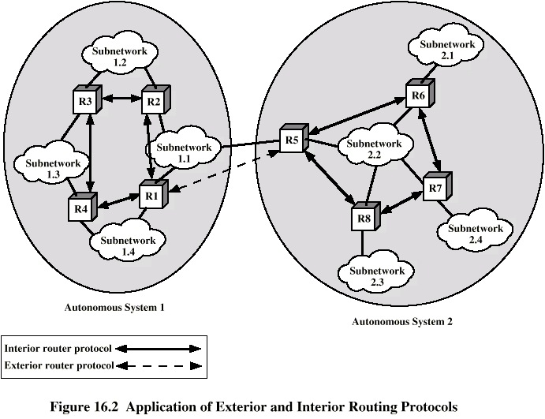
Application of IRP and ERP

Slide 30
Approaches to Routing –
Distance-vector
Each node (router or host) exchange information with neighboring nodes
  Neighbors are both directly connected to same network
First generation routing algorithm for ARPANET
Node maintains vector of link costs for each directly attached network and distance and next-hop vectors for each destination
Used by Routing Information Protocol (RIP)
Requires transmission of lots of information by each router
  Distance vector to all neighbors
  Contains estimated path cost to all networks in configuration
  Changes take long time to propagate

Slide 31
Approaches to Routing –
Link-state
Designed to overcome drawbacks of distance-vector
When router initialized, it determines link cost on each interface
Advertises set of link costs to all other routers in topology
  Not just neighboring routers
From then on, monitor link costs
  If significant change, router advertises new set of link costs
Each router can construct topology of entire configuration
  Can calculate shortest path to each destination network
Router constructs routing table, listing first hop to each destination
Router does not use distributed routing algorithm
  Use any routing algorithm to determine shortest paths
  In practice, Dijkstra's algorithm
Open shortest path first (OSPF) protocol uses link-state routing.
Also second generation routing algorithm for ARPANET

Slide 32
Exterior Router Protocols –
Not Distance-vector
Link-state and distance-vector not effective for exterior router protocol
Distance-vector assumes routers share common distance metric
ASs may have different priorities
  May have restrictions that prohibit use of certain other AS
  Distance-vector gives no information about ASs visited on route

Slide 33
Exterior Router Protocols –
Not Link-state
Different ASs may use different metrics and have different restrictions
  Impossible to perform a consistent routing algorithm.
Flooding of link state information to all routers unmanageable

Slide 34
Exterior Router Protocols –
Path-vector
Dispense with routing metrics
Provide information about which networks can be reached by a given router and ASs crossed to get there
  Does not include distance or cost estimate
Each block of information lists all ASs visited on this route
  Enables router to perform policy routing
  E.g. avoid path to avoid transiting particular AS
  E.g. link speed, capacity, tendency to become congested, and overall quality of operation, security
  E.g. minimizing number of transit ASs

Slide 35
Border Gateway Protocol (BGP)
For use with TCP/IP internets
Preferred EGP of the Internet
Messages sent over TCP connections
  Open
  Update
  Keep alive
  Notification
Procedures
  Neighbor acquisition
  Neighbor reachability
  Network reachability

Slide 36
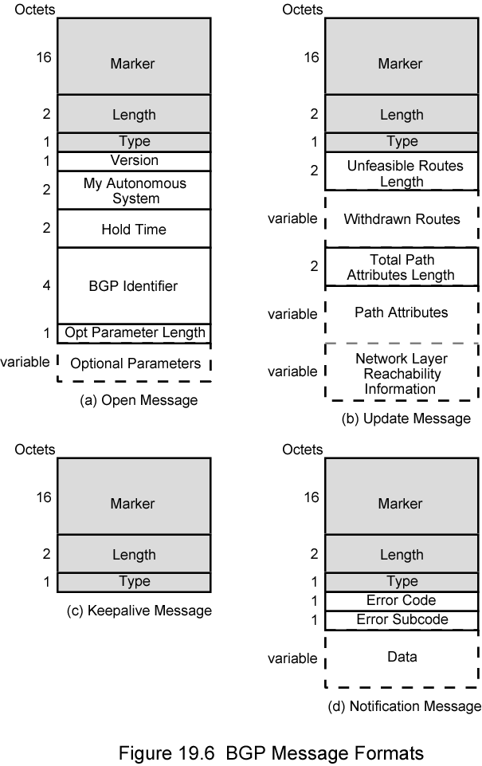
BGP Messages

Slide 37
BGP Procedure
Open TCP connection
Send Open message
  Includes proposed hold time
Receiver selects minimum of its hold time and that sent
  Max time between Keep alive and/or update messages

Slide 38
Message Types
Keep Alive
  To tell other routers that this router is still here
Update
  Info about single routes through internet
  List of routes being withdrawn
  Includes path info
    Origin (IGP or EGP)
    AS_Path (list of AS traversed)
    Next_hop (IP address of boarder router)
    Multi_Exit_Disc (Info about routers internal to AS)
    Local_pref (Inform other routers within AS)
    Atomic_Aggregate, Aggregator (Uses address tree structure to reduce amount of info needed)

Slide 39
Uses of AS_Path and Next_Hop
AS_Path
  Enables routing policy
    Avoid a particular AS
    Security
    Performance
    Quality
    Number of AS crossed
Next_Hop
  Only a few routers implement BGP
    Responsible for informing outside routers of routes to other networks in AS

Slide 40
Notification Message
Message header error
  Authentication and syntax
Open message error
  Syntax and option not recognized
  Unacceptable hold time
Update message error
  Syntax and validity errors
Hold time expired
  Connection is closed
Finite state machine error
Cease
  Used to close a connection when there is no error

Slide 41
BGP Routing Information Exchange
Within AS, router builds topology picture using IGP
Router issues Update message to other routers outside AS using BGP
These routers exchange info with other routers in other AS
Routers must then decide best routes

Slide 42
Open Shortest Path First (1)
OSPF
IGP of Internet
Replaced Routing Information Protocol (RIP)
Uses Link State Routing Algorithm
  Each router keeps list of state of local links to network
  Transmits update state info
  Little traffic as messages are small and not sent often
  RFC 2328
Route computed on least cost based on user cost metric

Slide 43
Open Shortest Path First (2)
Topology stored as directed graph
Vertices or nodes
  Router
  Network
    Transit
    Stub
Edges
  Graph edge
    Connect two router
    Connect router to network

Slide 44
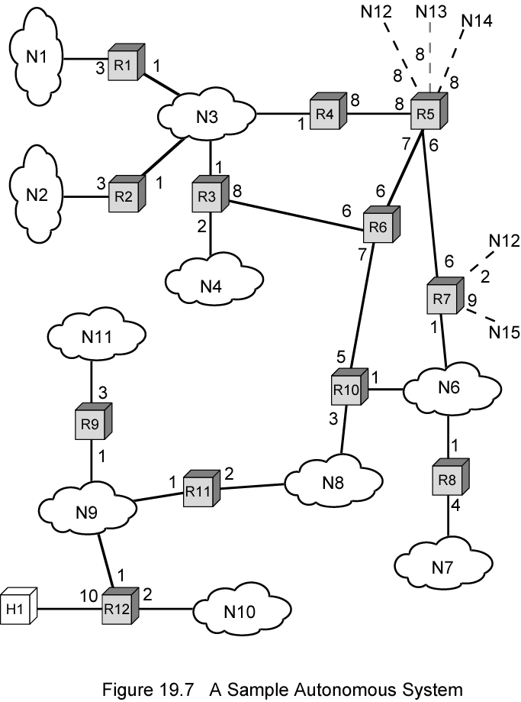
Sample AS

Slide 45
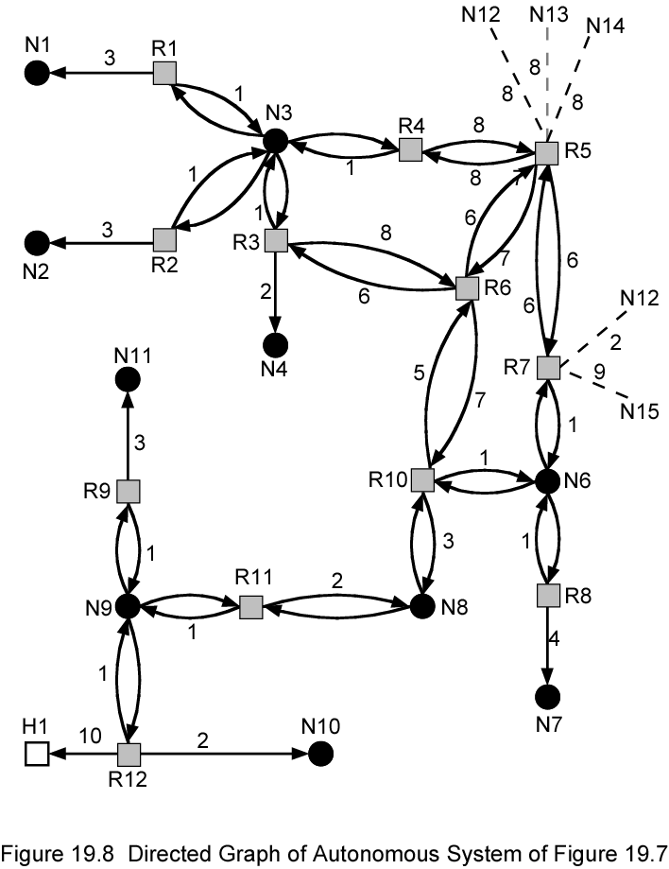
Directed
Graph of AS

Slide 46
Operation
Dijkstra’s algorithm used to find least cost path to all other networks
Next hop used in routing packets

Slide 47
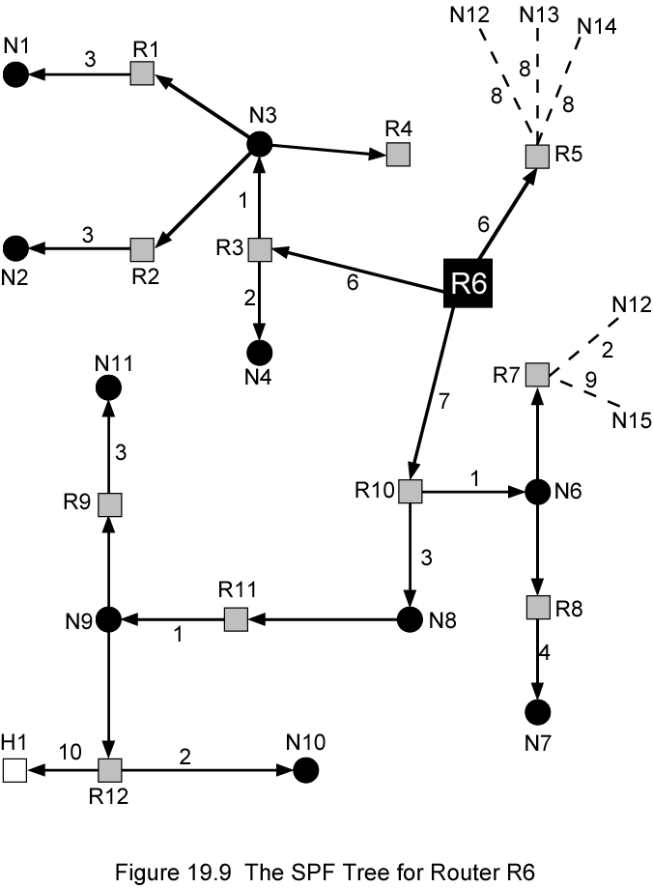
SPF Tree for Router 6

Slide 48
Integrates Services Architecture
Changes in traffic demands require variety of quality of service
Internet phone, multimedia, multicast
New functionality required in routers
New means of requesting QoS
ISA
RFC 1633

Slide 49
Internet Traffic
Elastic
  Can cope with wide changes in delay and/or throughput
    FTP sensitive to throughput
    E-Mail insensitive to delay
    Network Management sensitive to delay in times of heavy congestion
    Web sensitive to delay
Inelastic
  Does not easily adapt to variations
  e.g. real time traffic

Slide 50
Requirements for Inelastic Traffic
Throughput
Delay
Jitter
  Delay variation
Packet loss
Require preferential treatment for certain types of traffic
Require elastic traffic to be supported as well

Slide 51
ISA Approach
Congestion controlled by
  Routing algorithms
  Packet discard
Associate each packet with a flow
  Unidirectional
  Can be multicast
Admission Control
Routing Algorithm
Queuing discipline
Discard policy

Slide 52
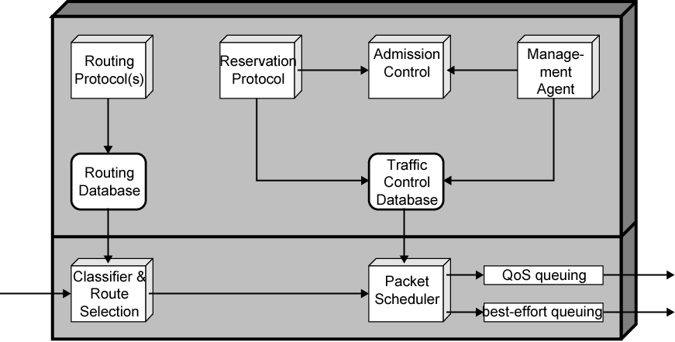
ISA in Router

Slide 53
Token Bucket Traffic Specification
Token replenishment rate R
  Continually sustainable data rate
Bucket size B
  Amount that data rate can exceed R for short period
  During time period T amount of data sent can not exceed RT + B

Slide 54
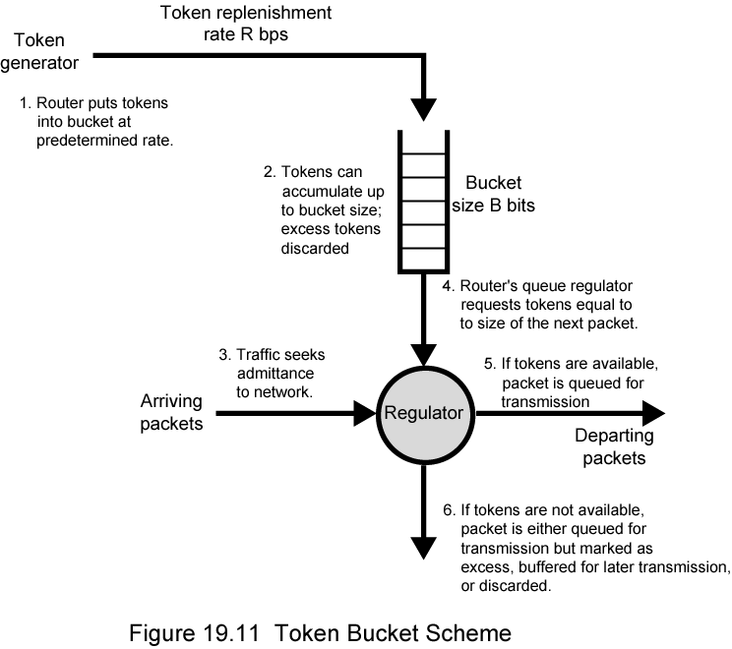
Token Bucket Scheme

Slide 55
ISA Services
Guaranteed
  Assured data rate
  Upper bound on queuing delay
  No queuing loss
  Real time playback
Controlled load
  Approximates behavior to best efforts on unloaded network
  No specific upper bound on queuing delay
  Very high delivery success
Best Effort

Slide 56
Queuing Discipline
Traditionally FIFO
  No special treatment for high priority flow packets
  Large packet can hold up smaller packets
  Greedy connection can crowd out less greedy connection
Fair queuing
  Queue maintained at each output port
  Packet placed in queue for its flow
  Round robin servicing
  Skip empty queues
  Can have weighted fair queuing

Slide 57
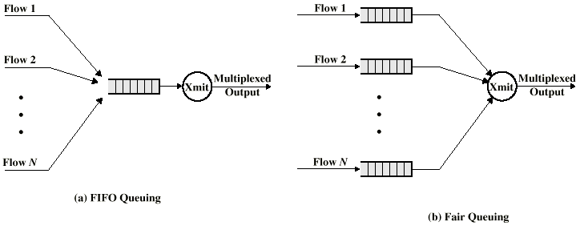
FIFO and Fair Queue

Slide 58
Resource Reservation: RSVP
RFC 2205
Unicast applications can reserve resources in routers to meet QoS
If router can not meet request, application informed
Multicast is more demanding
May be reduced
  Some members of group may not require delivery from particular source over given time
    e.g. selection of one from a number of “channels”
  Some group members may only be able to handle a portion of the transmission

Slide 59
Soft State
Set of state info in router that expires unless refreshed
Applications must periodically renew requests during transmission

Slide 60
RSVP Characteristics
Unicast and Multicast
Simplex
Receiver initiated reservation
Maintain soft state in the internet
Provide different reservation styles
Transparent operation through non-RSVP routers
Support for IPv4 and IPv6

Slide 61
Differentiated Services
Provide simple, easy to implement, low overhead tool to support range of network services differentiated on basis of performance
IP Packets labeled for differing QoS using existing IPv4 Type of Service or IPv6 Traffic class
Service level agreement established between provider and customer prior to use of DS
Built in aggregation
  Good scaling to larger networks and loads
Implemented by queuing and forwarding based on DS octet
  No state info on packet flows stored

Slide 62
DS Services
Defined within DS domain
  Contiguous portion of internet over which consistent set of DS policies are administered
  Typically under control of one organization
  Defined by service level agreements (SLA)

Slide 63
SLA Parameters
Detailed service performance
  Expected throughput
  Drop probability
  Latency
Constraints on ingress and egress points
Traffic profiles
  e.g. token bucket parameters
Disposition of traffic in excess of profile

Slide 64
Example Services
Level A - low latency
Level B - low loss
Level C - 90% of traffic < 50ms latency
Level D - 95% in profile traffic delivered
Level E - allotted twice bandwidth of level F traffic
Traffic with drop precedence X higher probability of delivery than that of Y

Slide 65
DS Octet - Code Pools
Leftmost 6 bits used
3 pools of code points
xxxxx0
  assignment as standards
xxxx11
  experimental or local use
xxxx01
  experimental or local but may be allocated for standards in future

Slide 66
DS Octet - Precedence Field
Routing selection
Network service
Queuing discipline

Slide 67
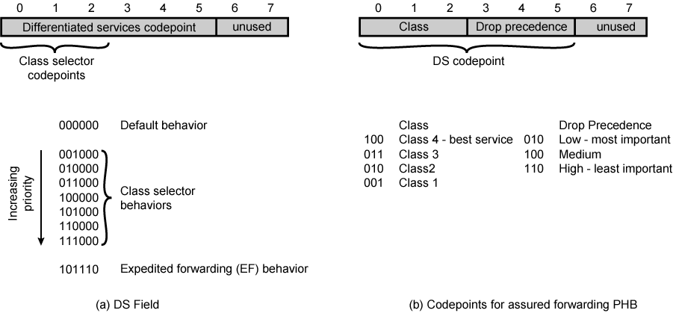
DS Field

Slide 68
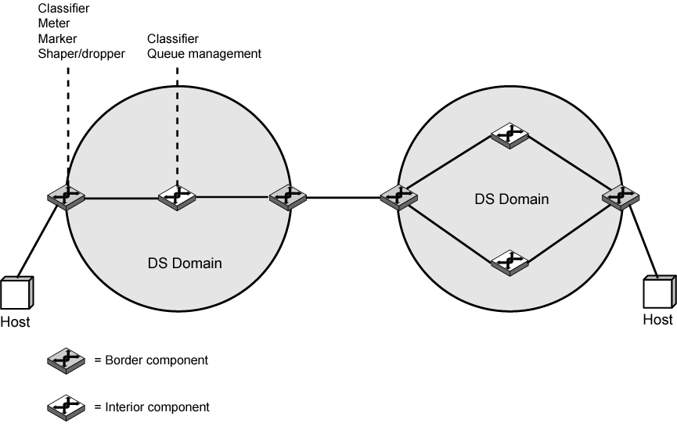
DS Domains

Slide 69
DS Configuration and Operation
Within domain, interpretation of DS code points is uniform
Routers in domain are boundary nodes or interior nodes
Traffic conditioning functions
  Classifier
  Meter
  Marker
  Shaper
  Dropper

Slide 70
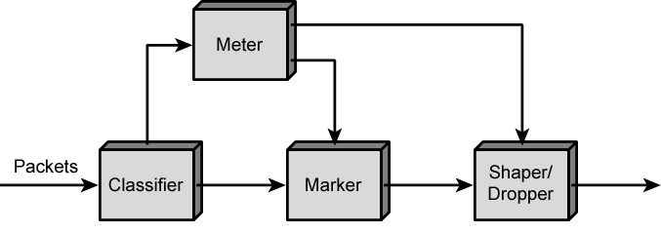
DS Traffic Conditioner

Slide 71
Per Hop Behavior –
Expedited Forwarding
Specific PHBs defined,
  Associated with specific differentiated services
RFC 3246 defines expedited forwarding (EF) PHB
  Support for premium service
  Low-loss, low-delay, low-jitter, assured bandwidth, end-to-end service through DS domains
  Appears to endpoints as point-to-point connection or leased line
Difficult in internet or packet-switching network
  Queues (buffers) at each node, or router
  Results in loss, delays, and jitter
  Unless internet grossly oversized, care needed in handling premium service traffic

Slide 72
Expedited Forwarding Requirements
Configuring nodes so traffic aggregate has minimum departure rate
Conditioning aggregate (via policing and shaping) so that arrival rate less than node's configured minimum departure rate
EF PHB provides first
Network boundary conditioners provide second
Border nodes control traffic aggregate
  Limit characteristics (rate, burstiness) to predefined level
Interior nodes treat traffic so no queuing effects
No specific queuing policy at interior nodes in RFC 3246
Simple priority scheme could achieve it
    EF traffic given absolute priority
    EF traffic must not overwhelm interior node
    Packet flows for other PHB traffic disrupted

Slide 73
Assured Forwarding PHB
Provide service superior to best-effort
Not require reservation of resources
Not require detailed discrimination among flows from different users
Based on explicit allocation
  Users offered choice of classes of service
    Each class describes different traffic profile
    Aggregate data rate and burstiness
  Traffic monitored at boundary node
    Each packet marked in or out of profile
  Inside network, no separation of traffic from different users or classes
    Only distinction being whether packet marked in or out
  When congested, out packets are dropped before in packets
  Different users will see different levels of service
    Have different quantities of in packets in service queues

Slide 74
Advantages of
Assured Forwarding PHB
Simplicity
  Very little work required by internal nodes
  Marking of traffic at boundary nodes based on traffic profiles provides different levels of service to different classes
C.f. ATM

Slide 75
AF PHB RFC 2597 (1)
Four AF classes defined
  Four distinct traffic profiles
Within each class, packets marked by customer or service provider
  Three drop precedence values
    Determines relative importance of packet within AF class
Simpler than resource reservation
Flexible
Within interior DS node, traffic from different classes treated separately
  Different amounts of resources (buffer space, data rate)

Slide 76
AF PHB RFC 2597 (2)
Within class, packets handled based on drop precedence
Level of forwarding assurance depends on:
  How much forwarding resources allocated to AF class that the packet belongs to
  Current load of class
  If congested within the class, drop precedence of packet
RFC 2597 does not mandate mechanisms at the interior nodes to manage AF traffic
  References RED algorithm

Slide 77
Required Reading
Stallings chapter 19
Comer, S. Internetworking with TCP/IP,
volume 1, Prentice-Hall
All RFCs mentioned plus any others connected with these topics
Loads of Web sites on TCP/IP, routing protocols etc.

